Slide 1

CUAI 스터디 CS224n1(NLP)팀
CS224n1팀: Natural Language Processing with Deep Learning
2022.05.17
발표자 : 김병찬

Slide 2
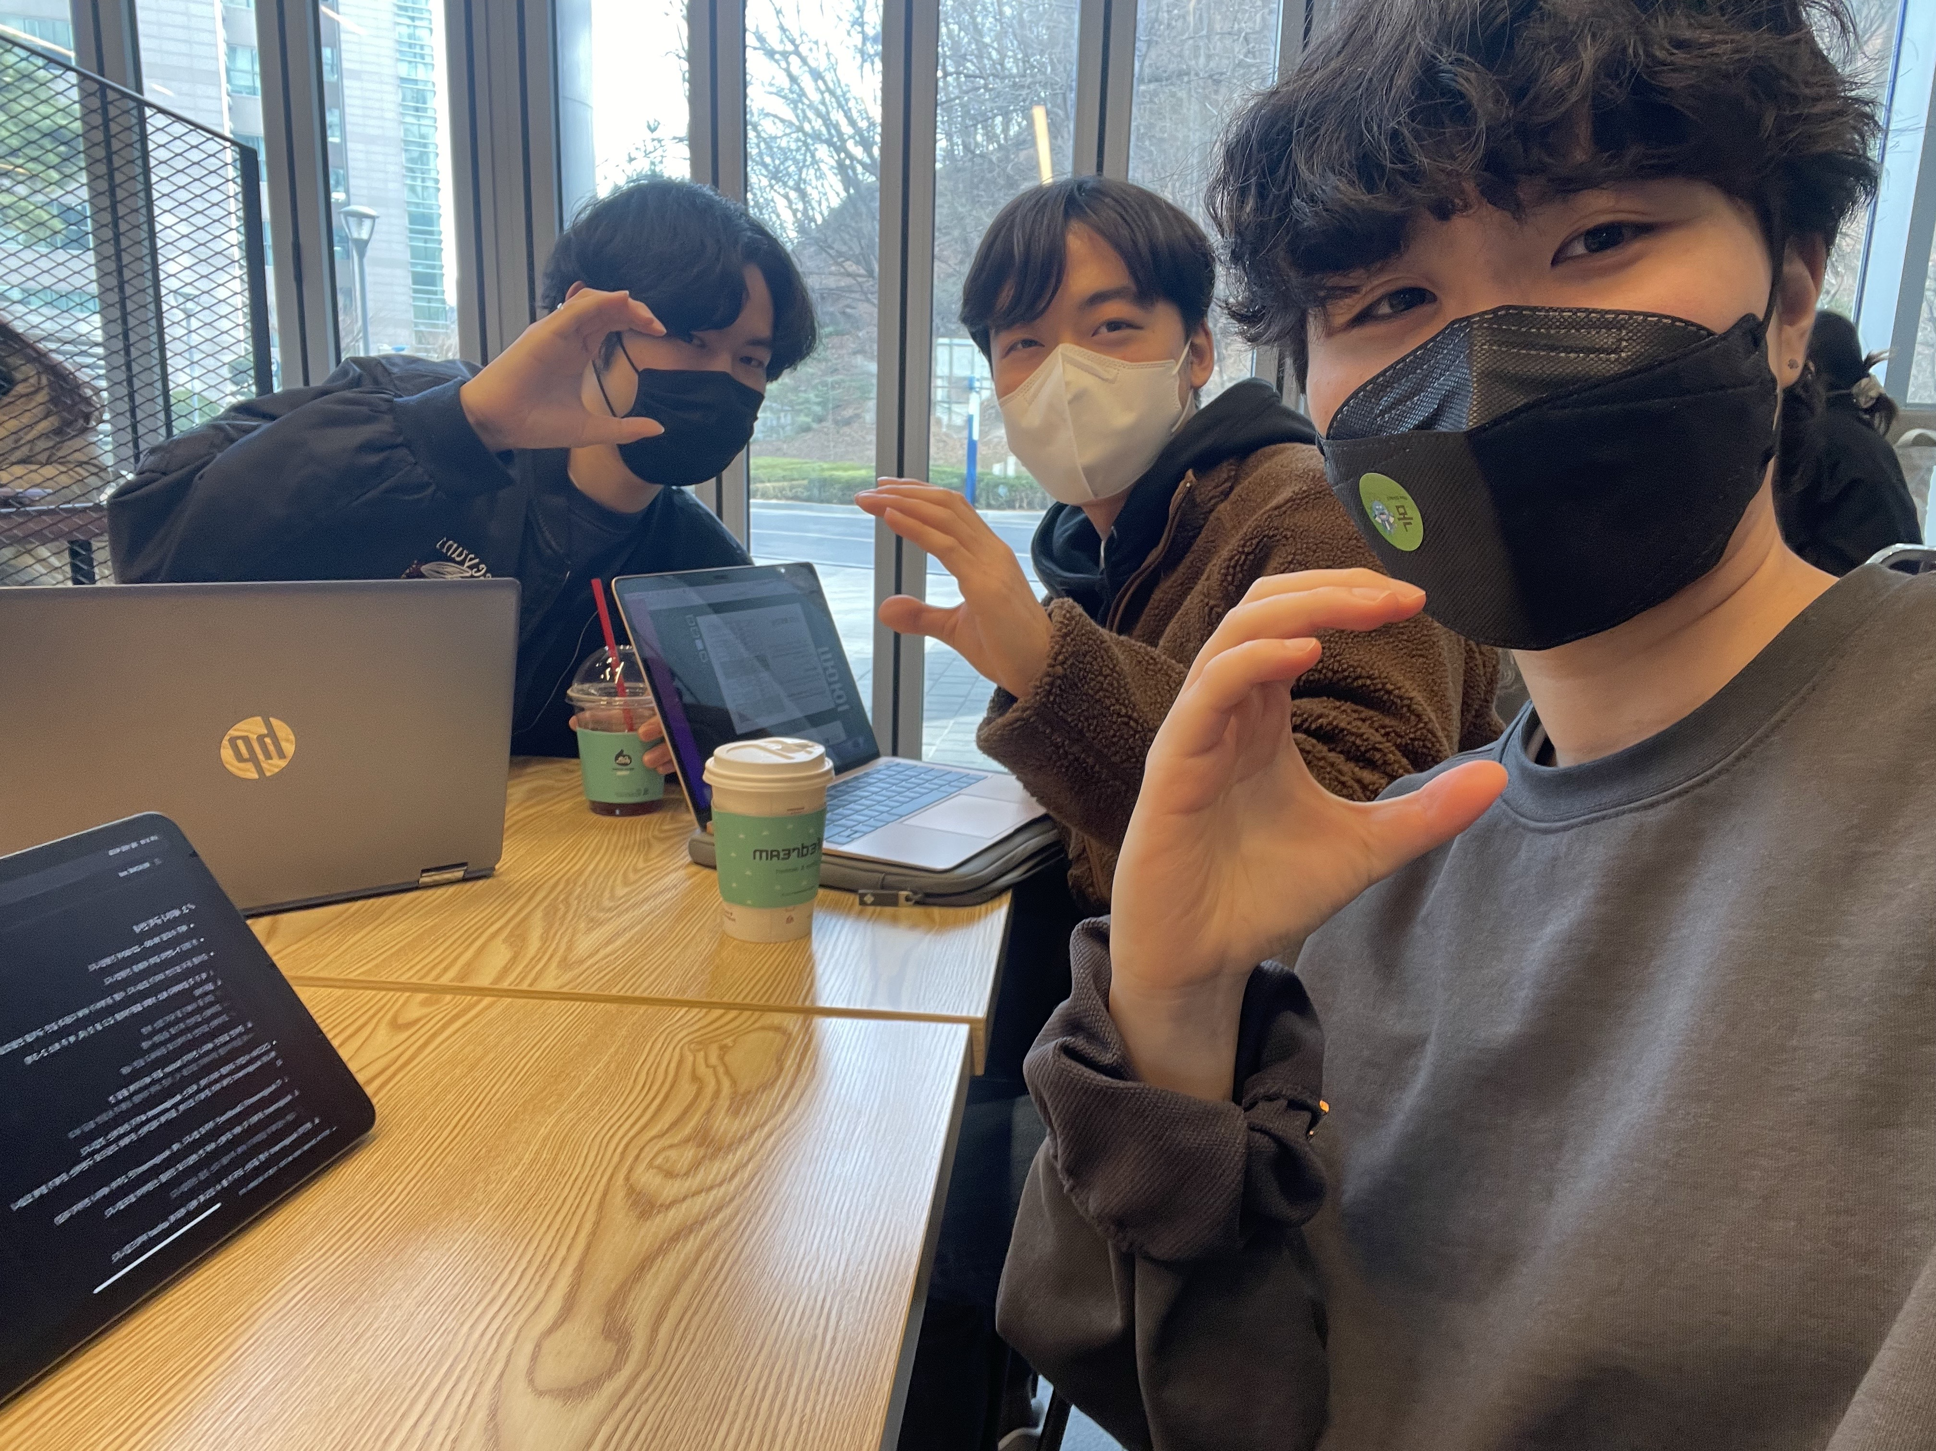
스터디원 1 : 김병찬(통계학과)
스터디원 2 : 김서린(응용통계학과)
스터디원 3 : 이재용(통계학과)
22.05.12. 16:00 – 17:00
응용통계학과 분석실에서 진행

Slide 3
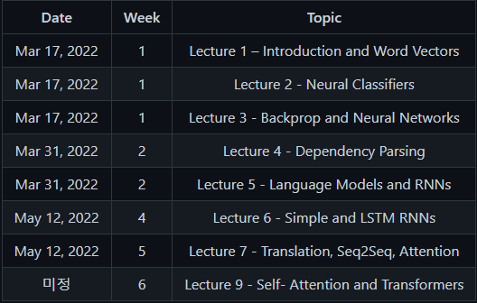
INDEX
RNN
LSTM
MACHINE TRANSLATION

Slide 4
INDEX
RNN
LSTM
MACHINE TRANSLATION

Slide 5
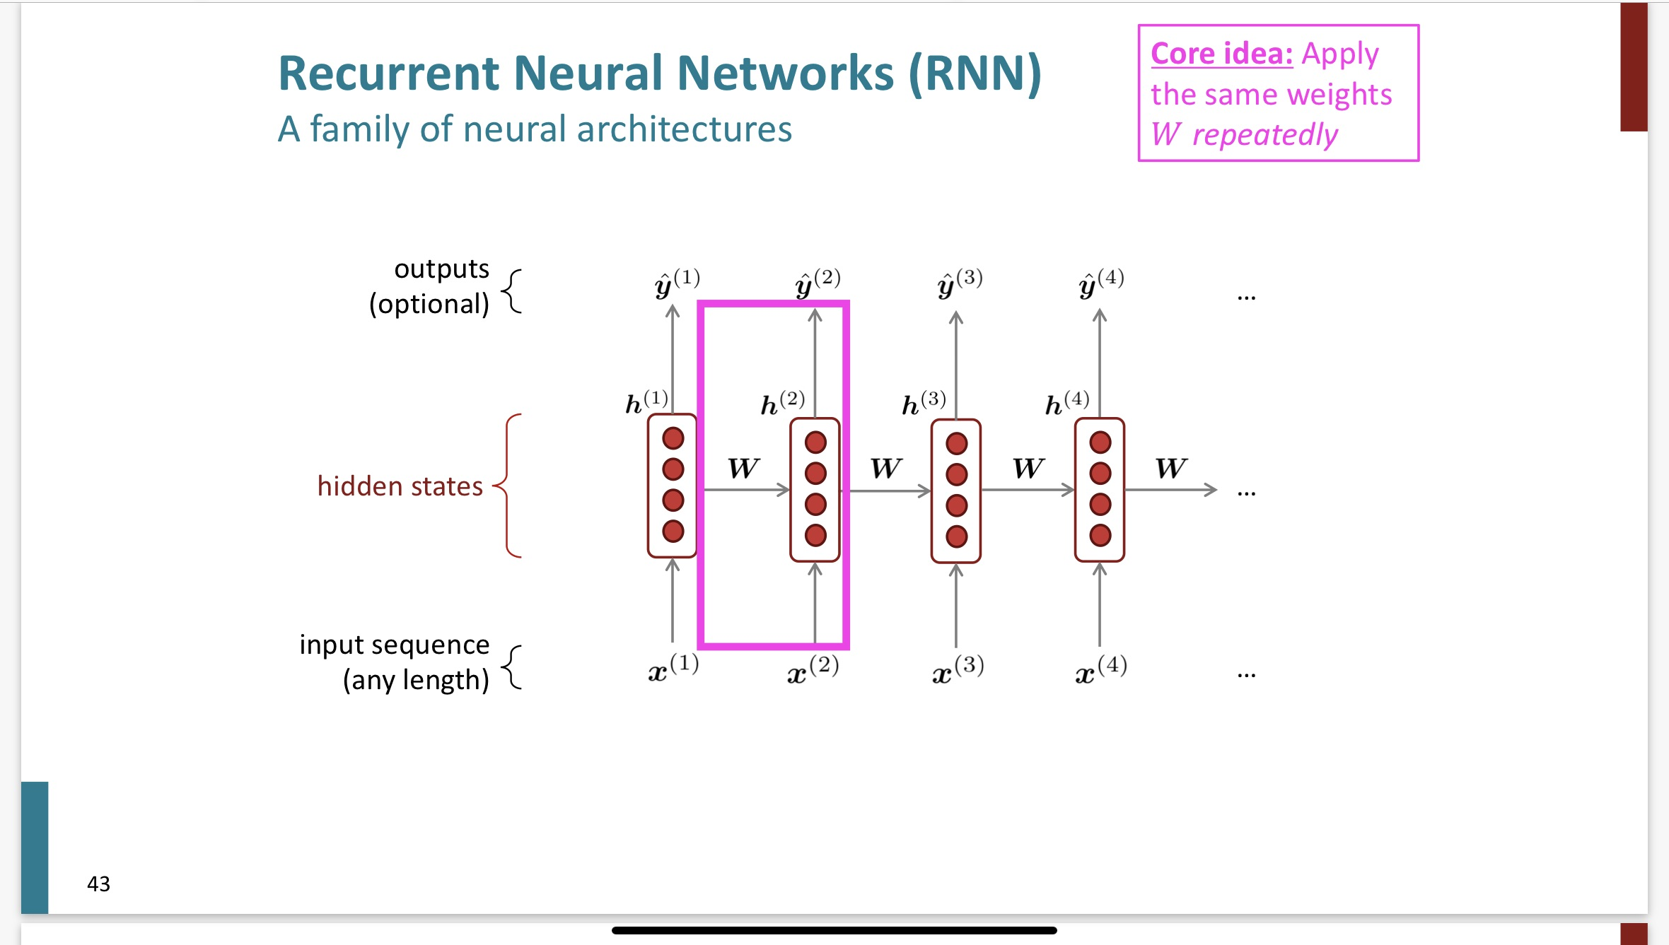
RNN

Slide 6
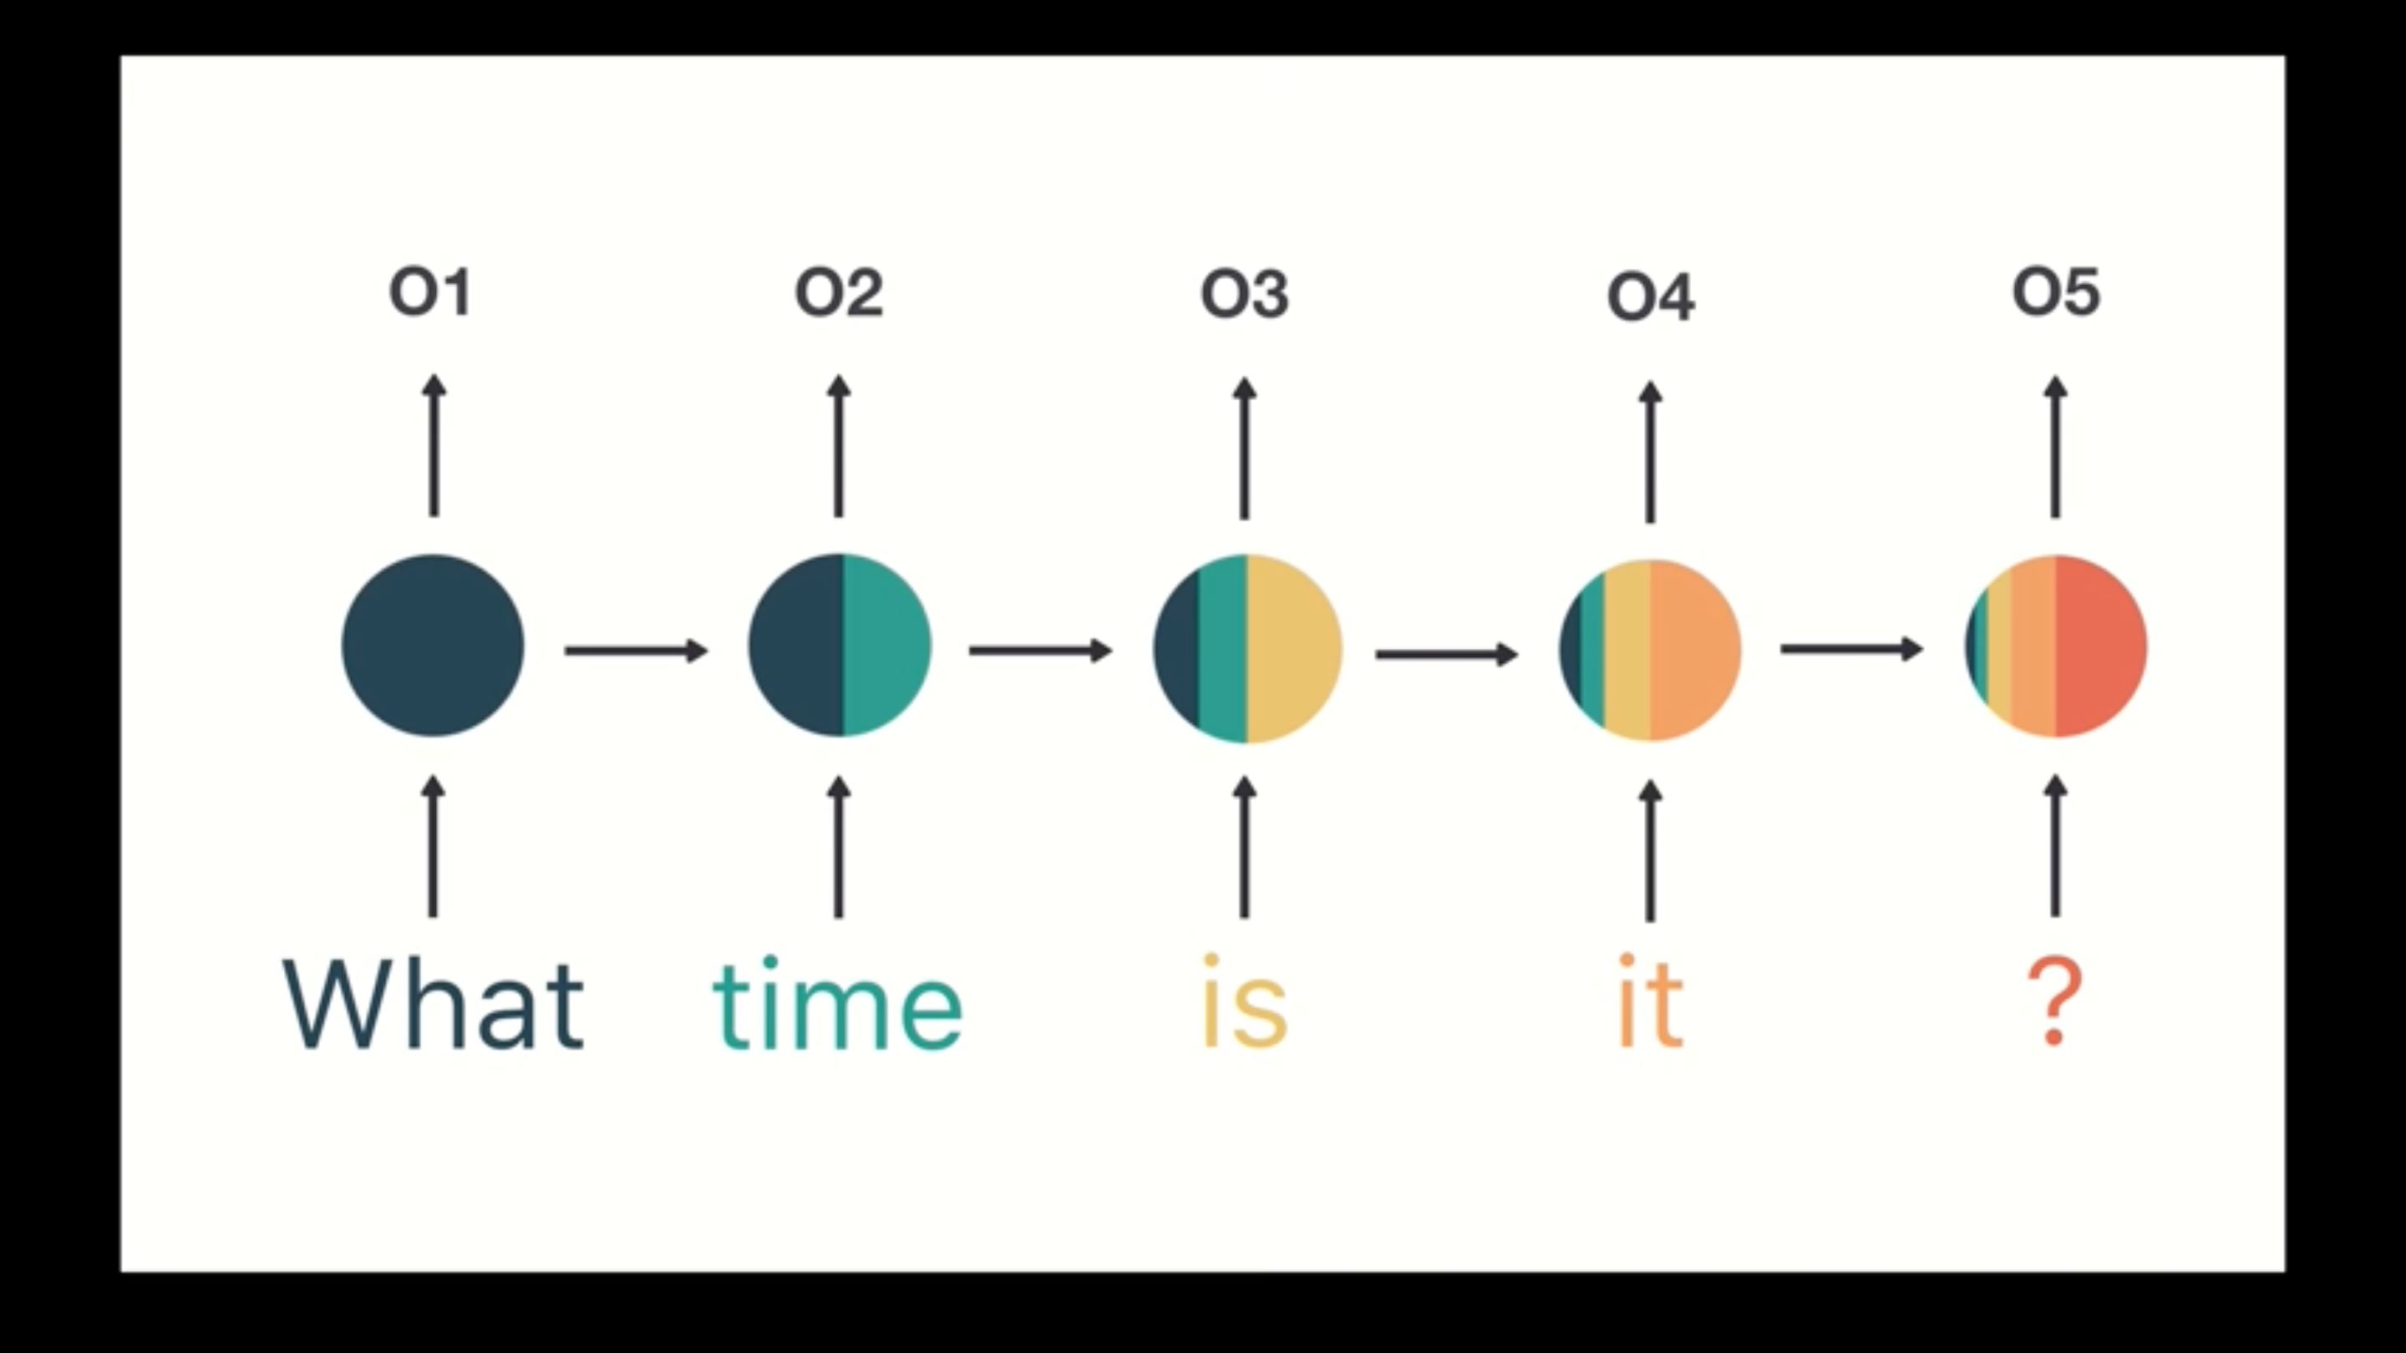
RNN

Slide 7
RNN
When she tried to print her tickets, she found that
the printer was out of toner. She went to the sta-
tionery store to buy more toner. It was very over-
priced. After installing the toner into the printer,
she finally printed her

Slide 8
RNN
When she tried to print her tickets, she found that
the printer was out of toner. She went to the sta-
tionery store to buy more toner. It was very over-
priced. After installing the toner into the printer,
she finally printed her
tickets

Slide 9
RNN
When she tried to print her tickets, she found that
the printer was out of toner. She went to the sta-
tionery store to buy more toner. It was very over-
priced. After installing the toner into the printer,
she finally printed her
tickets

Slide 10
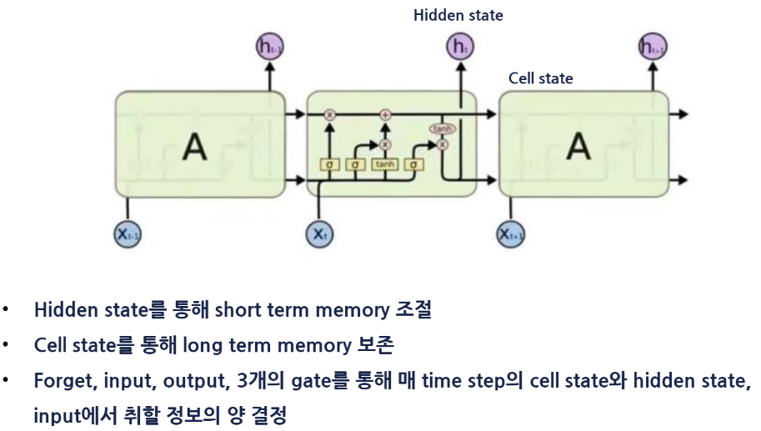
LSTM

Slide 11
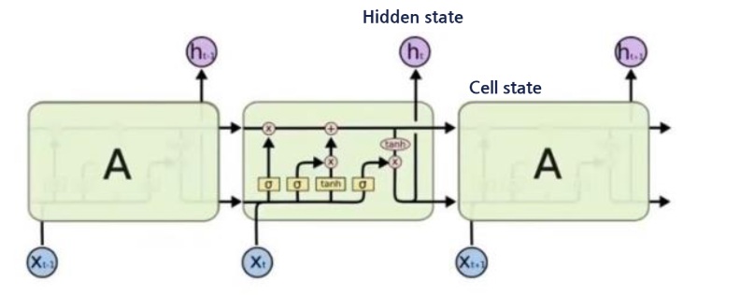
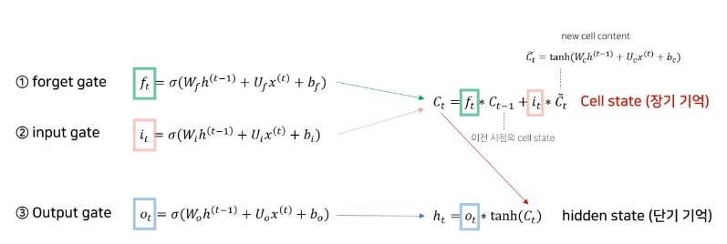
LSTM

Slide 12
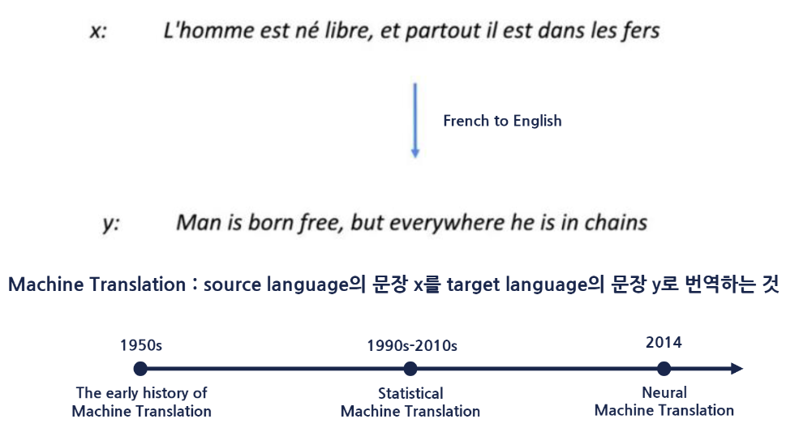
MACHINE TRANSLATION

Slide 13
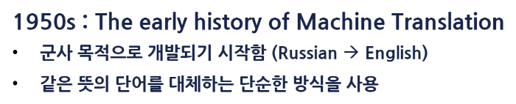
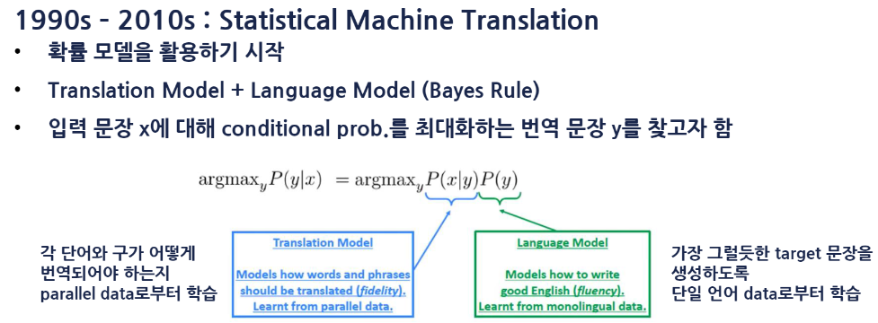
MACHINE TRANSLATION

Slide 14
MACHINE TRANSLATION
Statistical Machine Translation
많은 양의 병렬 데이터가 필요함

Slide 15
MACHINE TRANSLATION
Statistical Machine Translation
많은 양의 병렬 데이터가 필요함
나는 학생이다 (토큰 수 : 2)
I am a student (토큰 수 : 4)

Slide 16
MACHINE TRANSLATION
Statistical Machine Translation
많은 양의 병렬 데이터가 필요함
1대1 대응이 되지 않는 경우가 많음

Slide 17
MACHINE TRANSLATION
Statistical Machine Translation
많은 양의 병렬 데이터가 필요함
1대1 대응이 되지 않는 경우가 많음
사람의 노력이 많이 필요함

Slide 18
MACHINE TRANSLATION
Statistical Machine Translation
많은 양의 병렬 데이터가 필요함
1대1 대응이 되지 않는 경우가 많음
사람의 노력이 많이 필요함
많은 하위 시스템으로 전체시스템을 설계

Slide 19
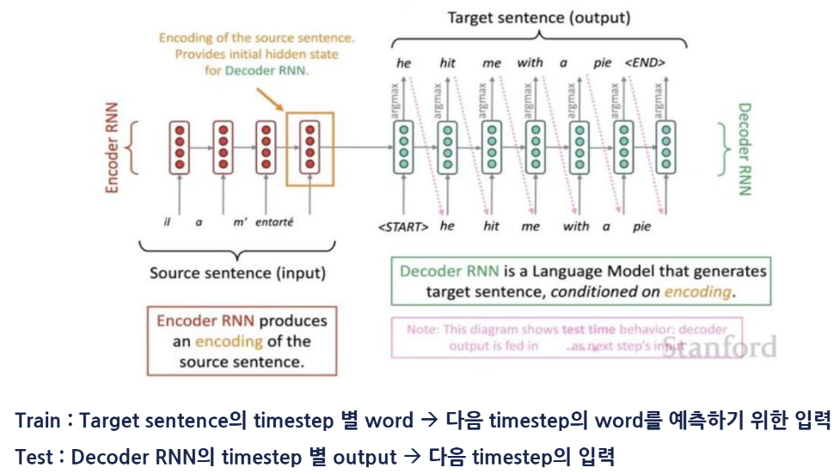
MACHINE TRANSLATION
Sequence to Sequence(Seq2Seq)

Slide 20
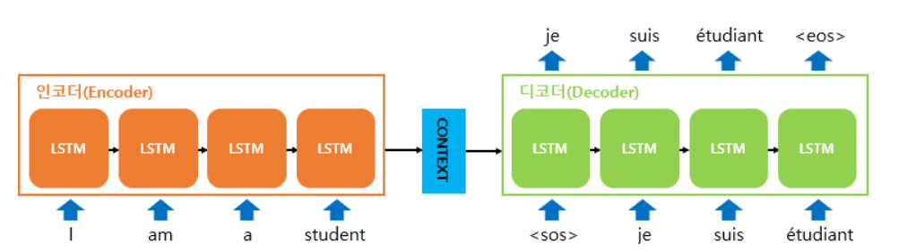
MACHINE TRANSLATION
Sequence to Sequence(Seq2Seq)
Multi-layers RNN
Greedy decoding
Beam searching decoding

Slide 21
MACHINE TRANSLATION
Sequence to Sequence(Seq2Seq)
병목현상 발생가능!

Slide 22
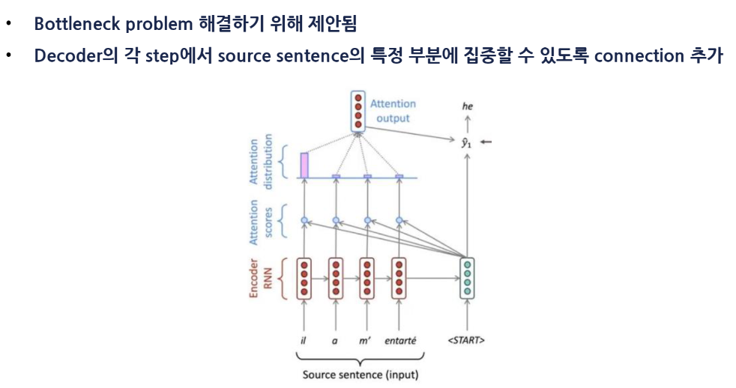
MACHINE TRANSLATION
Attention

Slide 23
감사합니다!!

